Slide 1
Morning Briefing Bot
Lars Oehler

Slide 2
Mission Statement
Build a programmable morning briefing system using the Raspberry Pi 3B+ with an integrated speaker system. The system will be activated daily at a time scheduled by the user and provide a customized morning briefing on weather, obligations, or news for the day.

Slide 3
Usefulness
Remind user of daily tasks.
Alarm clock
Entertainment

Slide 4
Similar Works
Daily Email Briefing with Pi:
https://mattcasmith.net/2019/03/09/raspberry-pi-home-hub-email-briefing/
Integrate local text to speech with Pi:
https://www.youtube.com/watch?v=rjq5eZoWWSo
Raspberry Pi Smart Mirror:
Youtube Tutorial: https://www.youtube.com/watch?v=fkVBAcvbrjU
Repository: https://github.com/HackerShackOfficial/Smart-Mirror

Slide 5
Briefing Pipeline
Python code to access relevant APIs
weather.gov
Python program to prompt user for events to be briefed on
Text To Speech library to construct audio output
Piper TTS
Library to convert digital audio files to analog audio output through 3.5mm jack
Speaker to connect to the Pi

Slide 6
Milestones
Download necessary libraries onto the Pi and write python code to enable audio files to be saved onto the Pi using a text to speech library
Connect a speaker to the Raspberry Pi and configure the system to convert/output digital audio through the 3.5mm headphone jack
Set up an HTML front end that will allow the user to program their daily briefings

Slide 7
Materials
Raspberry Pi 3B+
3.5mm TRS jack
Speaker
On/Off button to connect to the Pi
Miscellaneous cable/solder to connect On/Off button
Containment device for the setup (TBD)
Likely cardboard

Slide 8
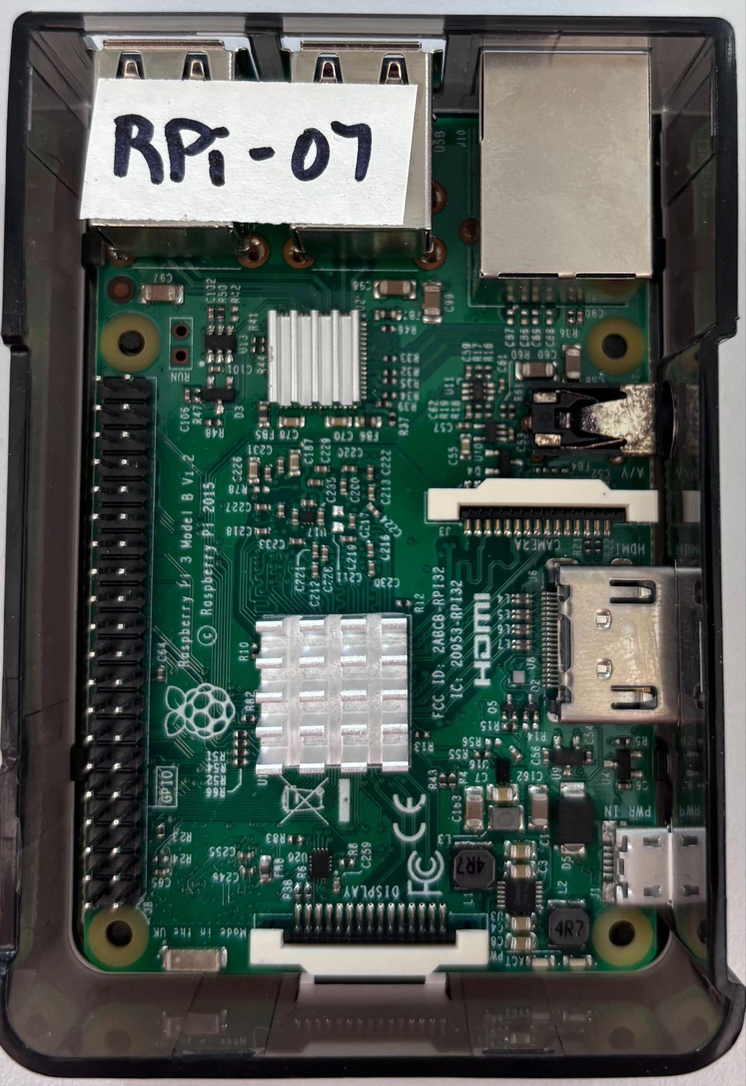

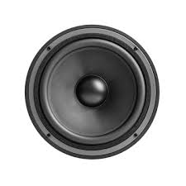
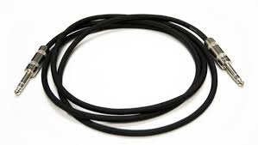
Visualization
Briefing Site Front End
TTS Library

